Slide 1

Knowledge Graph Analytics for Privacy Policy Analysis
Team Members: Mehak Kaur¹ (Team Leader), Julie Allen²
¹mk12462@georgiasouthern.edu ²ja23916@georgiasouthern.edu
April 30, 2026

Slide 2
Project Overview/Motivation/Why it Matters?
Privacy policies are complex and difficult to understand, limiting meaningful user consent
Companies often use vague language, reducing transparency
There are no effective tools to compare privacy practices across companies or industries
This project uses a Knowledge Graph to analyze policies, assess compliance, and reveal industry-wide patterns

Slide 3
Progress Update
Initial Node Types
ACTOR — any entity that collects or handles data. Examples: "we", "service provider"
DATA — any data type or category. Examples: "personal information", "email address", "cookie", "health information", "ssn"
Initial Edge Types
COLLECT — an ACTOR collects a DATA type. Examples: "we" → "email address", "advertiser" → "cookie"
SUBSUM — a broad DATA category encompasses a more specific sub-type. Examples: "personal information" ⊇ "email address", "contact information" ⊇ "phone number."

Slide 4
Progress Update
Unified Knowledge Graph (cross-company)
Company node: one of 184 S&P 500 firms
Sector node: IT / Healthcare / Financial
Regulation node: General Data Protection Regulation (GDPR)/California Consumer Privacy Act (CCPA)/Health Information Privacy (HIPAA)
IN_SECTOR edge: company belongs to sector
BELONGS_TO edge: entity links to category
REGULATED_BY edge: data point covered by regulation
Initial Knowledge Graph
ACTOR node: entity collecting data
DATA node: data type or category
COLLECT edge: actor → data collected
SUBSUM edge: broad category ⊇ sub-type
Company → Sector (Example: Apple_Inc. → IT )
Company → Entity → Category → DataPoint → Regulation (Apple_Inc. → "we" → “personal information” → “email address” → GDPR/CCPA/HIPAA)

Slide 5
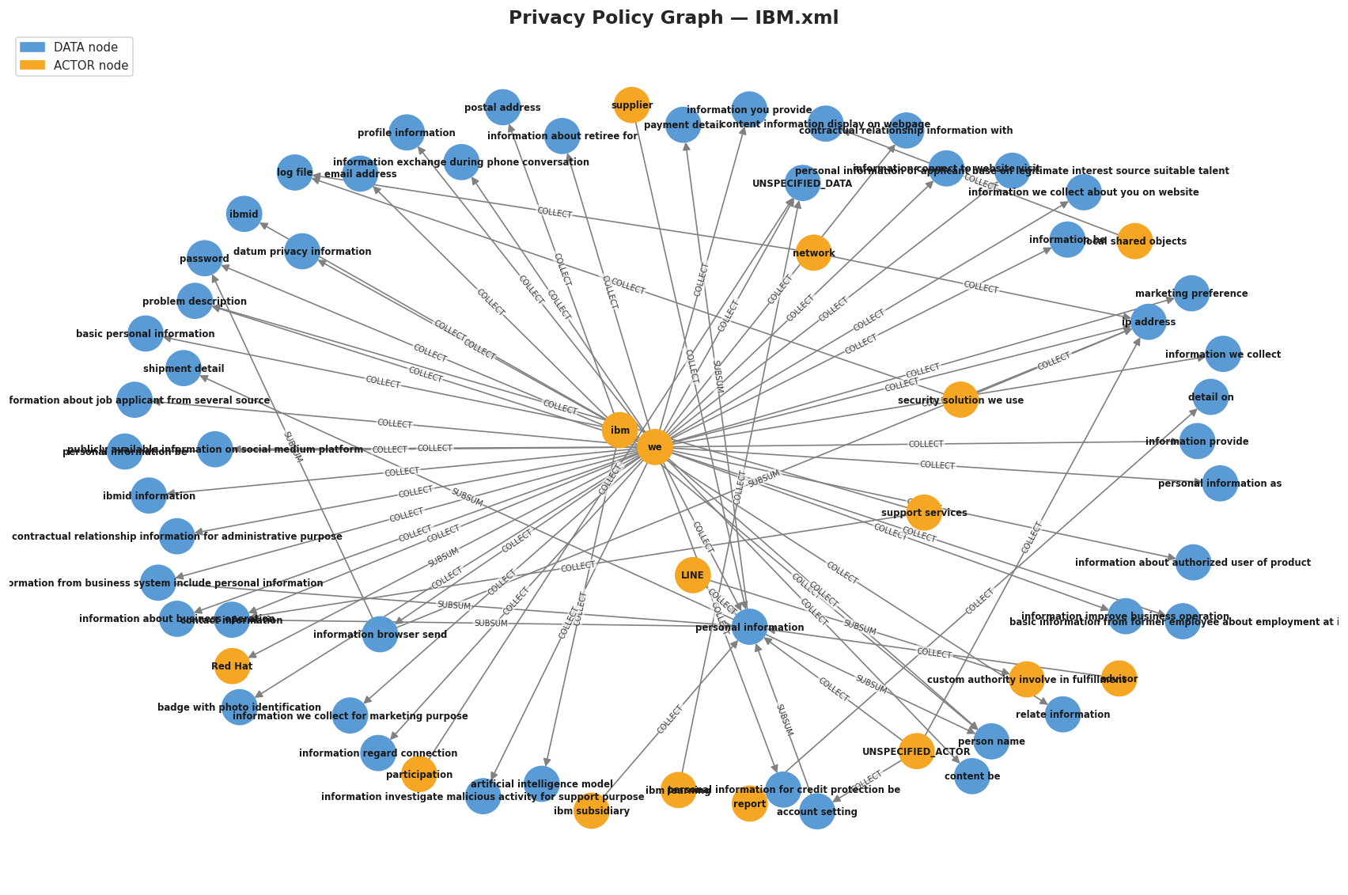
Initial Knowledge Graph
Relationship Summary
COLLECT - 62 edges
SUBSUM - 10 edges

Slide 6
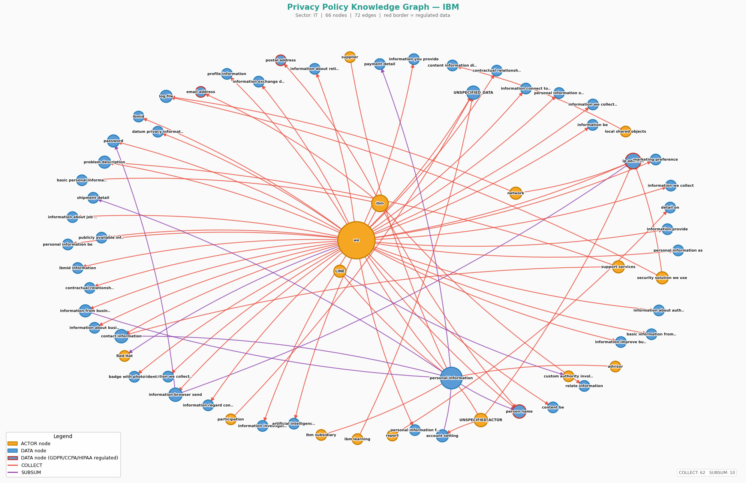
Unified Knowledge Graph
Regulated DATA nodes
email address
ip address
person name
postal address

Slide 7
Final Dataset Description
Privacy policies from 184 S&P 500 companies represented as GraphML knowledge graphs across Healthcare (56), IT (66), and Financial (62) sectors
Graph structure models actors collecting data, data categories, and relationships using COLLECT and SUBSUM edges
Preprocessing pipeline extracts quadruples (company, entity, category, data point) and removes placeholder nodes before analysis
Data points are mapped to GDPR, CCPA, and HIPAA regulatory vocabularies using official definitions from legal sources

Slide 8
Updated Framework
① DATA INGESTION & EDA
Collect policy files
Load GraphML on Healthcare, IT, Financial (184 S&P 500 companies)
Nodes
Clauses · Types · Entities
Edges
Shares · Requires · Collects
② PREPROCESSING & CLEANING
Normalize labels
Filter unspecified data
③ FEATURE EXTRACTION
Quadruple extraction
(company, entity, category, data point)
COLLECT + SUBSUM relationships
④ KG CONSTRUCTION & ANALYSIS
Initial Knowledge Graph: Actor-Data-Collect -Subsum
Unified Knowledge Graphs: Company Sector Regulation Nodes
⑤ Analysis
Graph Algorithms: BFS-DFS-Shortest Path
Centrality analysis: In-degree PageRank
Cross-sector comparisons
Regulatory Mapping: GDPR-CCPA-HIPPA
Overlay Regulations on sector-level KGs
Notes:
The updated Framework shows our five-stage pipeline for turning privacy policies into knowledge graphs with a privacy policy overlay.
We start by collecting data from 184 S&P 500 companies in Healthcare, IT, and Financial Services.
Next, we normalize and filter the data.
We then extract key relationships using quadruples: company, entity, category, and data point.
After that, we build unified sector-level knowledge graphs.
Finally, we apply analytics and map regulations like GDPR, CCPA, and HIPAA for sector comparison.

Slide 9
RQ1: Cross-Sector Connections -What privacy policy connections exist across IT, Healthcare, and Financial Services? Which data types and actors are shared, which are sector-specific, and how does regulatory compliance exposure compare?
Revised Research Questions (RQs)
RQ2: Within-Sector Structure - What data types, third-party actors, and collection patterns are characteristic of each sector's privacy policies?

Slide 10
Findings & Observations
RQ1: What privacy policy connections exist across IT, Healthcare, and Financial?

Slide 11
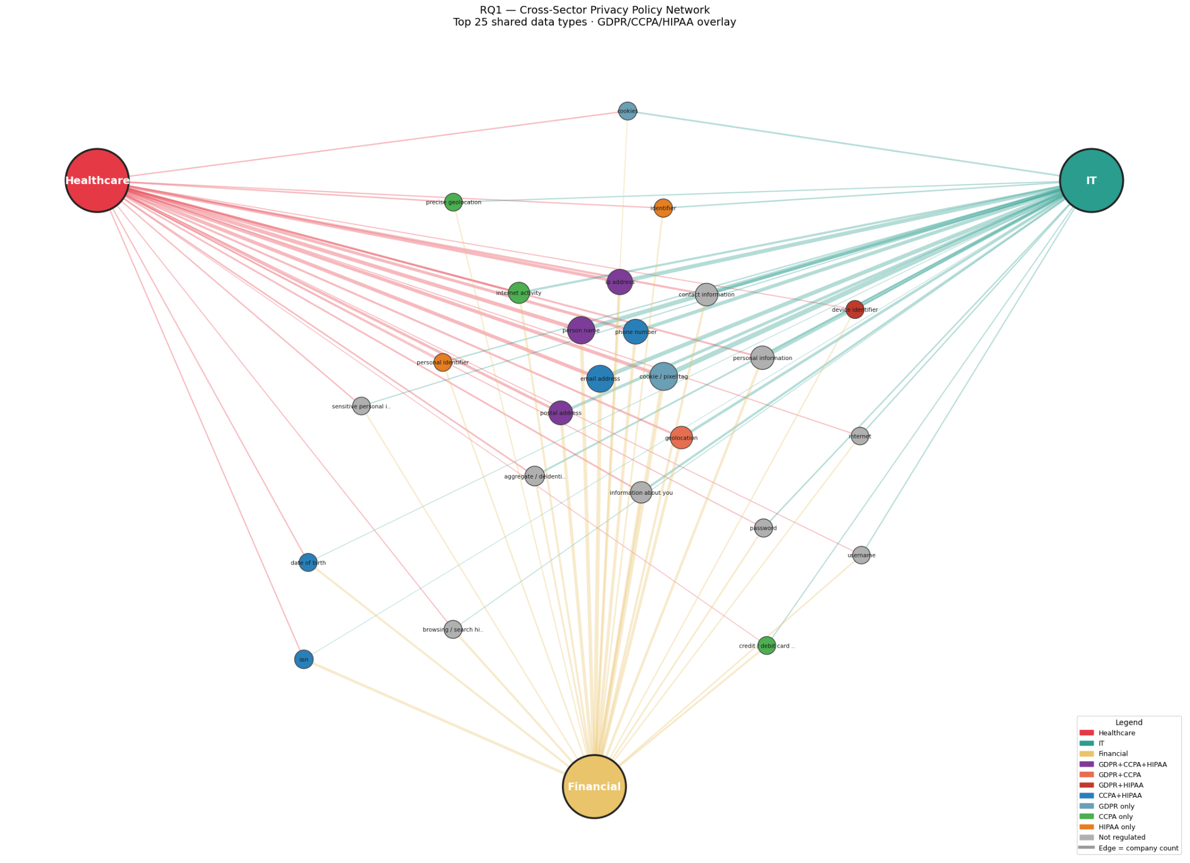
Notes:
This graph reveals sector connections on data type with a regulation overlay based on the three privacy regulations, GDPR, CCPA, and HIPPA. For example, person name is common to all sectors and present in all regulations indicating broad compliance within sectors. Conversely, browsing/search history is commmon to all sectors, but not present in the regulations. This highlights potential concerns with why companies are capturing history and what they are doing with the data. Username is another example of a data type common to all sectors but not specifically named in the regulation. This raises a separate concern about regulation complexity. In the case of GDRP, for example, username is not directly referenced but it is regulated under personal data if, and only if, it includes personally identifying information like name or unique email address (add section from GDPR for reference)

Slide 12
RQ1a - Which data types are most shared?
Data Type | Healthcare | IT | Financial
Cookie/pixel tag | 52% | 65% | 58%
Person name | 59% | 58% | 48%
Email address | 54% | 53% | 53%
IP address | 46% | 52% | 39%
Phone number | 43% | 45% | 40%
Notes:
The top 6 rows are the universal digital baseline — data types shared across all sectors, and the bottom 3 rows are where sectors diverge on sensitive identifiers.

Slide 13
RQ1b - Which data types are sector-specific?
Data Type | Sector | Why it is Distinctive
SSN | Financial only at 34% | Identity verification, GLBA requirement
Biometric info | Financial highest at 21% | Banking authentication apps
Date of Birth | Financial at 26% | Age verification,
Browsing/Search History | Financial at 27% | Ad-tech embedded in fintech
Cookie/pixel tag | IT highest at 65% | Ad and analytics infrastructure
Device identifier | IT at 18% | Multi-platform tracking
Sensitive personal info | Healthcare at 16% | HIPAA-adjacent language
Photograph | Healthcare at 4% | Clinical imaging context
Notes:
The top 6 rows are the universal digital baseline — data types shared across all sectors, and the bottom 3 rows are where sectors diverge on sensitive identifiers.
The KG’s reveals the highest ranking data types by organizational sector. These are the distinctive data types that are most common in each sector. Interestingly, we observe that browsing/search history is present in the Financial sector, raising the question about why a financial institution would need this type of information on you.

Slide 14
RQ1c - How does regulatory compliance exposure compare?
Regulation | Healthcare | IT | Financial
GDPR | 45/56 (80%) | 58/66 (88%) | 55/62 (89%)
CCPA | 43/56 (77%) | 54/66 (82%) | 54/62 (87%)
HIPAA | 40/56 (71%) | 51/66 (77%) | 50/62 (81%)
Notes:
HIPAA exposure is highest in Financial (81%) — counterintuitive, explained by overlap between financial identifiers (SSN, account number, date of birth) and HIPAA's 18 Safe Harbor identifiers.
HIPAA exposure in IT is 77% — meaning 51 out of 66 IT companies collect data matching HIPAA identifiers even though they are not Healthcare companies
HIPAA exposure in Financial is 81% — 50 out of 62 Financial companies are in HIPAA scope
This is counterintuitive and is your strongest finding

Slide 15
Findings & Observations - Search Algorithms
Algorithm | What It Traced | Findings | Implications
Breadth First Search (BFS) | Breadth of "personal information" | 406 direct children, GDPR reachable in 2 hops | Umbrella term hides hundreds of specific data types
Depth First Search (DFS) | Depth of "health information" | Only 3 nodes, no sub-types | HIPAA violation candidate
Shortest path | Distance from company to data | 2 hops for both companies | Direct collection is universal
All paths | Routes from "we" to GDPR | 1,142 paths | Vague policy still means full regulatory exposure
Notes:
Graph algorithms trace how data flows. BFS shows breadth — how much hides inside one umbrella term like “personal information”. DFS shows depth — or the lack of it. Shortest path confirms directness. All paths proves 1,142 ways vague language still reaches regulation.

Slide 16
Findings & Observations - Centrality Measures
Measure | Question Answered | Findings
PageRank | Who has the most influence? | "personal information" dominates
In-Degree | Who gets pointed at most? | UNSPECIFIED_ACTOR = 146 (vague disclosures)
Betweenness | Who connects everything? | "personal information" is the chokepoint
Notes:
Centrality analysis reveals that "personal information" is structurally dominant across all three measures — highest PageRank, highest in-degree, and highest betweenness — confirming it functions as a universal catch-all disclosure mechanism. The entity "we" similarly dominates, indicating companies are the primary collectors in their own policies. Most critically, UNSPECIFIED_ACTOR's in-degree of 146 reveals that a substantial proportion of data collection edges cannot be attributed to a named party, representing the clearest compliance risk signal in the corpus.

Slide 17
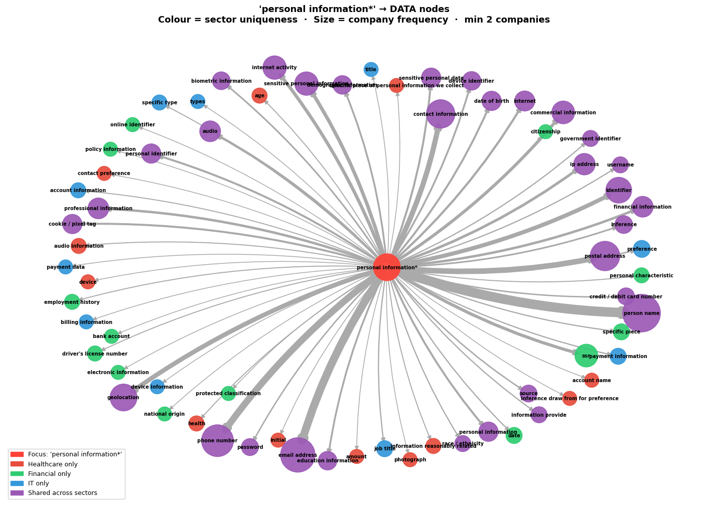
Notes:
This Knowledge graph displays a critical node of personal information and its connected subdata types and highlights the challenges of handling privacy regulation texts with different phrasing or identifying words for similar data types. It also highlights data types that are shared across all sectors or unique to various sectors. This reveals the importance of drilling down to lower levels of data for deeper investigation and identification.

Slide 18
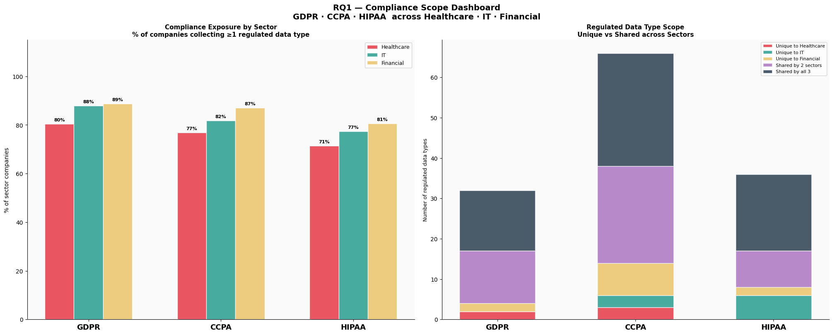
Notes:
Left: All three sectors are 77–89% exposed to every regulation — the differences between sectors are less than 10%, meaning no sector has a meaningfully higher compliance exposure than another. Since the Financial sector has other regulations it must comply with like the Gramm Leach Bliley Act and it is heavily regulated, that may account for the slightly higher rates of compliance exposure.
Right: CCPA covers the most data types (68), most regulated types are shared across all three sectors (dark grey dominates every bar), and GDPR is the narrowest in scope (32 types) but still universal. This is surprising considering that GDPR is much longer than the other regulations, but it may be due to its complexity that the underlying meaning is more difficult to identify, such as in the example given earlier with browsing/search history.

Slide 19
Findings & Observations
RQ2: What data types, third-party actors, and collection patterns are characteristic of each sector's privacy policies?

Slide 20
#2 data collected
RQ2 — Within-Sector Comparison
Metric | Healthcare | IT | Financial
Avg nodes / company | 36.6 | 43.9 | 42.0
Avg edges / company | 41.3 | 49.8 | 49.9
Sector KG edges | 105 | 110 | 123
Top data collected | Person name (59%) | Cookie/pixel tag (65%) | Cookie/pixel tag (58%)
#2 data collected | Email Address (54%) | Person name (58%) | Email Address (53%)
#3 data collected | Cookie/pixel tag (52%) | Email Address (53%) | Person name (48%)
Most distinctive type | Sensitive personal info (16%) | Cookie/pixel tag (65%) | SSN (34%)
Top third-party actor | Social media (36%) | Service provider (26%) | Service provider (40%)
Unique data vocabulary | 715 types | 718 types | 715 types
Notes:
IT leads on tracking data, Financial on sensitive financial identifiers, Healthcare on regulated health-adjacent categories.

Slide 21
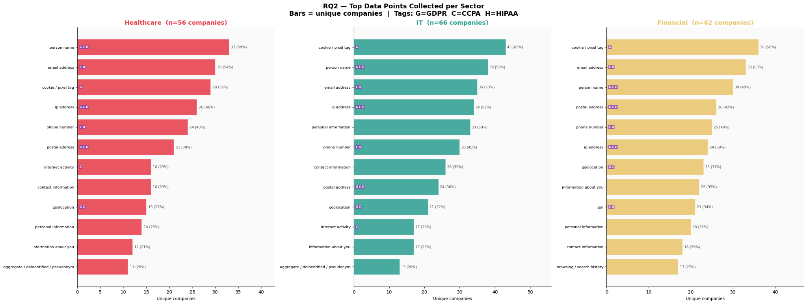
Findings & Observations (RQ2)
Notes:
This chart extends the within sector comparison to overlay the privacy regulations that reference the data type. For example, cookie pixel tag, the top item in IT and Financial sectors is only specifically related to GDPR in our KG edges, but not the CCPA or HIPPA regulation. That could be useful information to uncover as regulations change over time.

Slide 22
Reflections
What went well?
Unified KG revealed patterns invisible in text
Cross-sector scale (184 companies, 3 sectors)
Centrality surfaced unexpected findings (UNSPECIFIED_ACTOR, 146 edges)
Challenges?
Graph shows structure—domain knowledge needed to interpret legal significance
Policies are intentionally vague - hard to build a graph of deliberate ambiguity
Privacy policies use heterogeneous terminology to describe the same underlying concept
How did we overcome it?
Grounded every finding in actual regulatory text
Cross-validated across multiple analyses
Data normalization

Slide 23

Thank You!

Slide 24
References
[1] S. Barrett, V. Ramasamy, G. Dorai, and B. Boswell, “Navigating privacy policies with nlp and graph mining: Advancements in user-centric legal document analysis,” in SoutheastCon 2025, pp. 1013–1022, 2025.
[2] V. Ramasamy, S. Barett, G. Dorai, and J. Zumbach, “Unveiling privacy policy complexity: An exploratory study using graph mining, machine learning, and natural language processing,” in 2025 6th International Conference on Artificial Intelligence, Robotics and Control (AIRC), pp. 514–520, 2025.
[3] J. Yerby and I. Vaughn, “Deliberately confusing language in terms of service and privacy policy agreements,” Issues in information systems., vol. 23, no. 2, pp. 138–149, 2022.
[4] Z. Munn, J. Peters, Micah D. C. Stern, C. Tufanaru, A. McArthur, and E. Aromataris, “Systematic review or scoping review? guidance for authors when choosing between a systematic or scoping review approach,” BMC Medical Research Methodology, vol. 18, no. 1, p. 143, 2018.
[5] H. Cui, R. Trimananda, A. Markopoulou, and S. Jordan, “PoliGraph:Automated privacy policy analysis using knowledge graphs,” in 32nd USENIX Security Symposium (USENIX Security 23), (Anaheim, CA), pp. 1037–1054, USENIX Association, Aug. 2023.
[6] K. P. Joshi, L. Elluri, and A. Nagar, “An integrated knowledge graph to automate cloud data compliance,” IEEE Access, vol. 8, pp. 148541–148555, 2020.

Slide 25
References
[7] V. Belcheva, T. Ermakova, and B. Fabian, “Understanding website privacy policies—a longitudinal analysis using natural language processing,”Information, vol. 14, no. 11, 2023.
[8] L. Garza, L. Elluri, A. Piplai, A. Kotal, D. Gupta, and A. Joshi, “Privcomp-kg: Leveraging kg and llm for compliance verification,” in 2024 IEEE 6th International Conference on Trust, Privacy and Security in Intelligent Systems, and Applications (TPS-ISA), pp. 97–106, 2024.
[9] H. Chowdhury, M. I. Morsalin, R. S. Azade, and V. Ramasamy, “Graphdpr: A privacy policy analysis framework using knowledge graphs and topic modeling.,” in Social Networks Analysis and Mining - 17th International Conference, ASONAM 2025, Proceedings, vol. 16322, pp. pp.422–430, 2026.
[10] S. of California; Department of Justice, “California consumer privacy act,” in oag.ca.gov, 2024.
[11] U. D. of Health and H. Services, “Health information privacy,” in HHS.gov, 2024.
[12] F. T. Commission, “How to comply with the privacy of consumer financial information rule of the gramm-leach-bliley act,” in ftc.gov, 1999.

